Slide 1


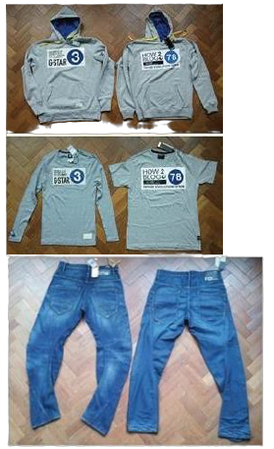
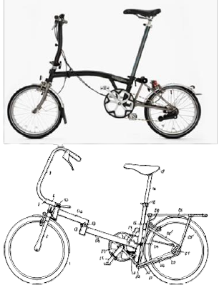
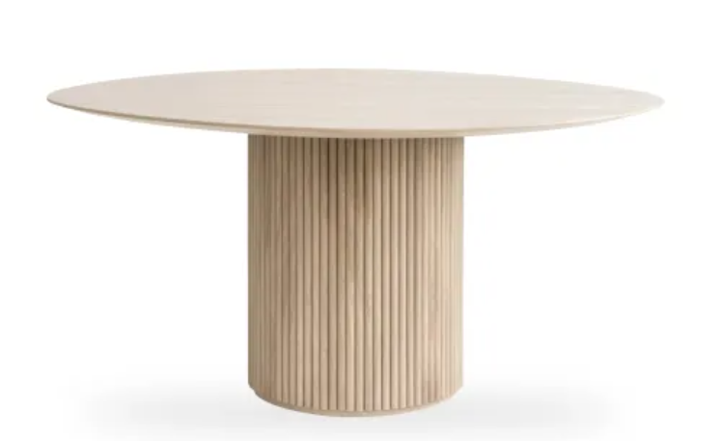



Copyright & applied art/design
WHEN CREATIVE
RIGHTS
EUIPO CASE LAW CONFERENCE
Alicante | 22 May 2026
Sukanya Wadhwa
sukanya@brandsmiths.co.uk
The role of copyright in design and trade mark disputes
BRANDSMITHS | BUILT FOR BRANDS

Slide 2

Copyright & applied art/design
WHEN CREATIVE
RIGHTS
The starting point: there is no exclusion for functional works
The assessment: originality only
EUIPO CASE LAW CONFERENCE
Alicante | 22 May 2026
“Although the protection reserved for designs and the protection ensured by copyright are not mutually exclusive… and may be granted cumulatively to the same subject matter, that concurrent protection is limited to certain situations…, since an author is deemed to create a unique work bearing the imprint of his or her personality, which, as such, is protected in accordance with Directive 2001/29. However, there is no relationship of rule and exception between the protection reserved for designs and the protection ensured by copyright.” (paragraph 55-56)
“the court considering the question of the originality of that subject matter may take into account the creative process and the author’s intentions, provided that those elements are expressed in that subject matter itself, but it cannot, however, base its assessment decisively on those elements.
(paragraph 75)
Sukanya Wadhwa
sukanya@brandsmiths.co.uk
The role of copyright in design and trade mark disputes
BRANDSMITHS | BUILT FOR BRANDS
Mio (C580/23) and Konektra (C795/23

Slide 3


“a thing to be looked at”
“a thing to be looked at”
Copyright & applied art/design
Section 51 Design documents and models
The starting point: there is no exclusion for functional works
The assessment: originality only
(1) It is not an infringement of any copyright in a design document or model recording or embodying a design for anything other than an artistic work or a typeface to make an article to the design or to copy an article made to the design.….
(3) In this section—
“design” means the design of the shape or configuration (whether internal or external) of the whole or part of an article, other than surface decoration
“Although the protection reserved for designs and the protection ensured by copyright are not mutually exclusive… and may be granted cumulatively to the same subject matter, that concurrent protection is limited to certain situations…, since an author is deemed to create a unique work bearing the imprint of his or her personality, which, as such, is protected in accordance with Directive 2001/29. However, there is no relationship of rule and exception between the protection reserved for designs and the protection ensured by copyright.” (paragraph 55-56)
“the court considering the question of the originality of that subject matter may take into account the creative process and the author’s intentions, provided that those elements are expressed in that subject matter itself, but it cannot, however, base its assessment decisively on those elements.
(paragraph 75)
Mio (C580/23) and Konektra (C795/23
BRANDSMITHS | BUILT FOR BRANDS
AGA RANGEMASTER GROUP LTD V UK INNOVATIONS GROUP LTD [2025] EWCA CIV 1622

Slide 4
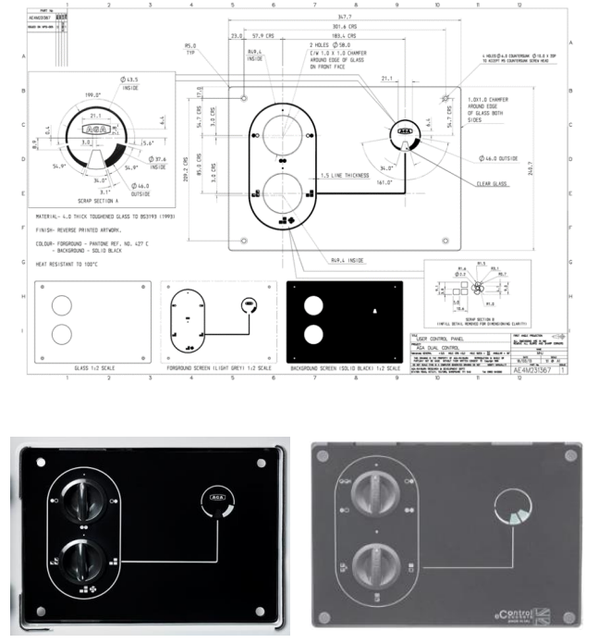
Copyright & applied art/design
“a thing to be looked at”
The starting point: there is no exclusion for functional works
The assessment: originality only
“Although the protection reserved for designs and the protection ensured by copyright are not mutually exclusive… and may be granted cumulatively to the same subject matter, that concurrent protection is limited to certain situations…, since an author is deemed to create a unique work bearing the imprint of his or her personality, which, as such, is protected in accordance with Directive 2001/29. However, there is no relationship of rule and exception between the protection reserved for designs and the protection ensured by copyright.” (paragraph 55-56)
“the court considering the question of the originality of that subject matter may take into account the creative process and the author’s intentions, provided that those elements are expressed in that subject matter itself, but it cannot, however, base its assessment decisively on those elements.
(paragraph 75)
Mio (C580/23) and Konektra (C795/23
AGA RANGEMASTER GROUP LTD V UK INNOVATIONS GROUP LTD [2025] EWCA CIV 1622
BRANDSMITHS | BUILT FOR BRANDS

Slide 5
“a thing to be looked at”
Section 51 Design documents and models
(1) It is not an infringement of any copyright in a design document or model recording or embodying a design for anything other than an artistic work or a typeface to make an article to the design or to copy an article made to the design.….
(3) In this section—
“design” means the design of the shape or configuration (whether internal or external) of the whole or part of an article, other than surface decoration
AGA RANGEMASTER GROUP LTD V UK INNOVATIONS GROUP LTD [2025] EWCA CIV 1622
BRANDSMITHS | BUILT FOR BRANDS

Slide 6



Copyright
& AI
“a thing to be looked at”
Section 51 Design documents and models
The prompt
The holding
(1) It is not an infringement of any copyright in a design document or model recording or embodying a design for anything other than an artistic work or a typeface to make an article to the design or to copy an article made to the design.….
“the actual creative process – the selection, combination, and design of the visual elements – is carried out entirely automatically by the AI.”
“Create a logo for a career & jobs notification application. For that, use the shape of a handshake and a bell icon, symbolizing an incoming job notification. The style and the colours should be trustworthy and rather simple. However, adapt the handshake and bell shapes to form something unique and creative, intermix them!”
(3) In this section—
“design” means the design of the shape or configuration (whether internal or external) of the whole or part of an article, other than surface decoration
AGA RANGEMASTER GROUP LTD V UK INNOVATIONS GROUP LTD [2025] EWCA CIV 1622
BRANDSMITHS | BUILT FOR BRANDS
AG München, Judgment of
Feb 13, 2026 – 142 C 9786/25)

Slide 7
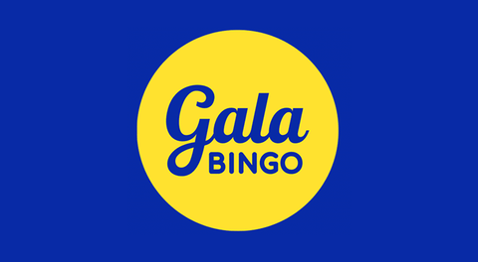

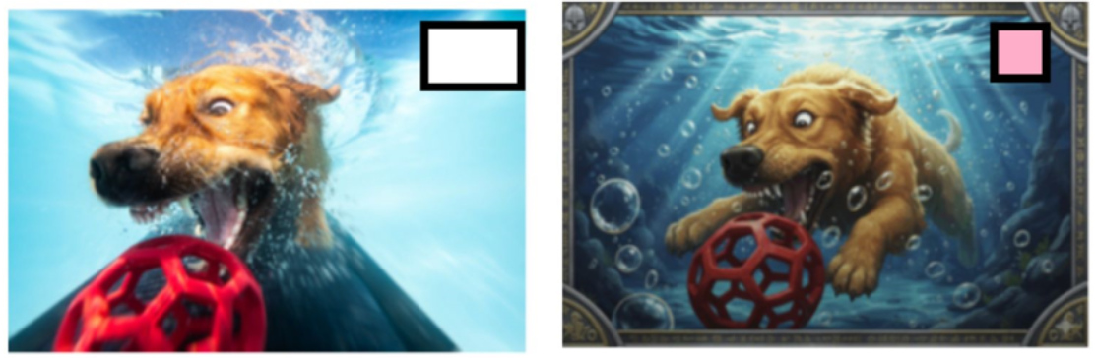








“a thing to be looked at”
Copyright
& AI
Issues with copyright within logo disputes
The Claimants’ casino logos
The Claimants’ sport logos
Section 51 Design documents and models
The prompt
Dates of creation
Lack of originality on face
Identity of the authors
Chain of title v trade mark register
(1) It is not an infringement of any copyright in a design document or model recording or embodying a design for anything other than an artistic work or a typeface to make an article to the design or to copy an article made to the design.….
“Create a logo for a career & jobs notification application. For that, use the shape of a handshake and a bell icon, symbolizing an incoming job notification. The style and the colours should be trustworthy and rather simple. However, adapt the handshake and bell shapes to form something unique and creative, intermix them!”
(3) In this section—
“design” means the design of the shape or configuration (whether internal or external) of the whole or part of an article, other than surface decoration
“the actual creative process – the selection, combination, and design of the visual elements – is carried out entirely automatically by the AI.”
AGA RANGEMASTER GROUP LTD V UK INNOVATIONS GROUP LTD [2025] EWCA CIV 1622
AG München, Judgment of
Feb 13, 2026 – 142 C 9786/25)
BRANDSMITHS | BUILT FOR BRANDS
German Higher Regional Court on April 2, 2026 (case no. I-20 W 2/26)

Slide 8
“a thing to be looked at”
Copyright
& AI
The prompt
The Claimants’ casino logos
The Claimants’ sport logos
“Create a logo for a career & jobs notification application. For that, use the shape of a handshake and a bell icon, symbolizing an incoming job notification. The style and the colours should be trustworthy and rather simple. However, adapt the handshake and bell shapes to form something unique and creative, intermix them!”
“the actual creative process – the selection, combination, and design of the visual elements – is carried out entirely automatically by the AI.”
AG München, Judgment of
Feb 13, 2026 – 142 C 9786/25)
German Higher Regional Court on April 2, 2026 (case no. I-20 W 2/26)
BRANDSMITHS | BUILT FOR BRANDS
Entain Operations Ltd & ors v Liquidity Trading Ltd & ors IL-2025-000145

Slide 9
Copyright
& trade mark
The Claimants’ casino logos
The Claimants’ sport logos
German Higher Regional Court on April 2, 2026 (case no. I-20 W 2/26)
Entain Operations Ltd & ors v Liquidity Trading Ltd & ors IL-2025-000145
BRANDSMITHS | BUILT FOR BRANDS
Thank you
Sukanya Wadhwa
sukanya@brandsmiths.co.uk
Senior Associate | IP Litigation
AG München, Judgment of
Feb 13, 2026 – 142 C 9786/25)
Notes:
Logos animate on first, all at same time

Slide 10
Copyright
& trade mark
BRANDSMITHS | BUILT FOR BRANDS
Issues with copyright within logo disputes
The Claimants’ casino logos
The Claimants’ sport logos
Dates of creation
Lack of originality on face
Identity of the authors
Chain of title v trade mark register
Unfair competition?
Thank you
Sukanya Wadhwa
sukanya@brandsmiths.co.uk
Senior Associate | IP Litigation
Entain Operations Ltd & ors v Liquidity Trading Ltd & ors IL-2025-000145

